Slide 1

Department of Computer Engineering
Minimization using Boolean function using K-map
1

Slide 2
Department Vision & Mission
Department of Computer Engineering
Vision
Achieve academic excellence through education in computing, to create intellectual manpower to explore professional, higher educational and social opportunities.
Mission
To impart learning by educating students with conceptual knowledge and hands on practices using modern tools, FOSS technologies and competency skills there by igniting the young minds for innovative thinking, professional expertise and research.
2

Slide 3
Department of Computer Engineering
Karnaugh maps (K-map)
K-map can be used to minimize boolean functions
Easy conversion from truth table to K-map to minimized SOP representation.
Simple rules (steps) used to perform minimization
Leads to minimized SOP representation.

Slide 4
Karnaugh maps (K-map)
Department of Computer Engineering
Alternate way of representing Boolean function
All rows of truth table represented with a square
Each square represents a minterm
Easy to convert between truth table, K-map, and SOP
number of 1’s in K-map equals number of minterms (products) in SOP
F (x.y) = Σ(m₀,m₁) = x’y’ + x’y
x y F
0 0 1
0 1 1
1 0 0
1 1 0
y
y
x
0
1
x
0
1
1
1
x’y’
x’y
0
0
1
x
1
0
0
xy’
xy

Slide 5
Department of Computer Engineering
Karnaugh maps (K-map)
F (A,B) = Σ(m₁,m₂)
F (A,B) = Σ(m₁,m_{2,} m₃ )
B
B
0
1
0
1
A
A
0
0
1
0
0
1
F= A’B + AB ′
F=A′B + AB ′ + AB
1
1
0
1
1
1
Three variable maps.
BC
A
B
C
F
BC
00
01
11
10
0
0
0
0
00
01
11
10
A
0
0
1
1
A
0
0
1
3
2
0
1
0
1
0
0
1
0
1
1
4
5
7
6
0
1
1
0
1
1
1
1
1
1
0
0
1
1
0
1
F= A’B’C + A’BC’ +
+ AB’C’+ AB ′C +ABC +ABC ′
1
1
1
0
1
1
1
1
1
+

Slide 6
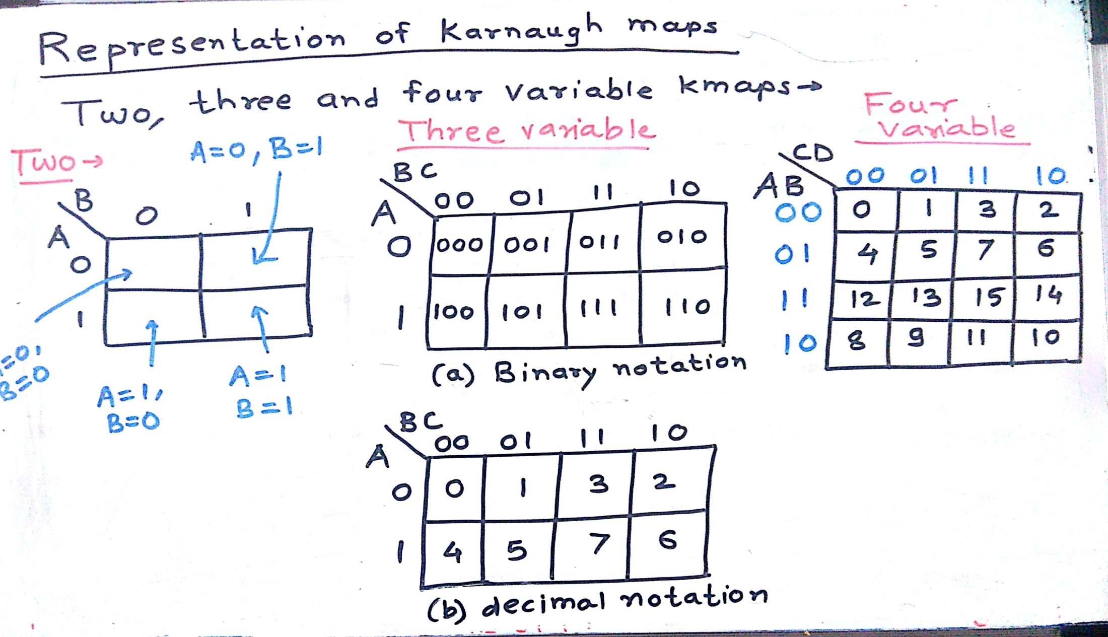
Karnaugh maps (K-map)
Department of Computer Engineering

Slide 7
Rules for K-Maps
Department of Computer Engineering
A Karnaugh map is a graphical tool for assisting in the general simplification procedure.
We can reduce functions by circling 1’s in the K-map
Each circle represents minterm reduction
Following circling, we can deduce minimized and-or form.
Rules to consider
Every cell containing a 1 must be included at least once.
The largest possible “power of 2” must be enclosed.
The 1’s must be enclosed in the smallest possible number of rectangles.
Example

Slide 8
Rules for K-Maps
Department of Computer Engineering
A Karnaugh map is a graphical tool for assisting in the general simplification procedure.
Two variable maps.
B
B
0
1
0
1
A
A
0
0
1
0
0
1
F=A+B
F=A’B +AB’
1
1
0
1
1
1
Three variable maps.
BC
A
00
01
11
10
0
0
1
0
1
F=A+B ′C +BC ′
1
1
1
1
1

Slide 9
Rules for K-Maps
Department of Computer Engineering
Numbering scheme based on Gray–code
e.g., 00, 01, 11, 10
Only a single bit changes in code for adjacent map cells
This is necessary to observe the variable transitions
AB
AB
A
A
00 01 11 10
C
00
01
11
10
C
0 0
0 0
1 1
1 1
0
G(A,B,C) =
A
1
C
C
B
B
AB
C
00
01
11
10
0
1 0
0 0
0 1
1 1
F(A,B,C) = Σm(0,4,5,7)
= AC + B’C’
1

Slide 10
More Karnaugh Map Examples
Department of Computer Engineering
Examples
a
b
0
1
a
0
0
1
b
0
1
1
0
1
0
1
1
f = a
1
0
0
g = b'
ab
ab
c
00
01
11
10
c
00
01
11
10
0
0
0
1
0
0
0
0
1
1
1
0
1
1
1
1
0
0
1
1
cout = ab + bc + ac
f = a
1. Circle the largest groups possible.
2. Group dimensions must be a power of 2.
3. Remember what circling means!

Slide 11
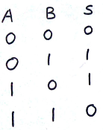
Two variable k-map
Department of Computer Engineering
S= F (A,B) = Σm(1,2)

Slide 12
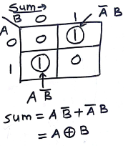
Two variable k-map
Department of Computer Engineering

Slide 13
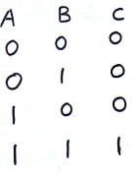
Two variable k-map
Department of Computer Engineering
C= F (A,B) = Σm(3)

Slide 14
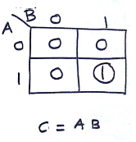
Two variable k-map
Department of Computer Engineering

Slide 15
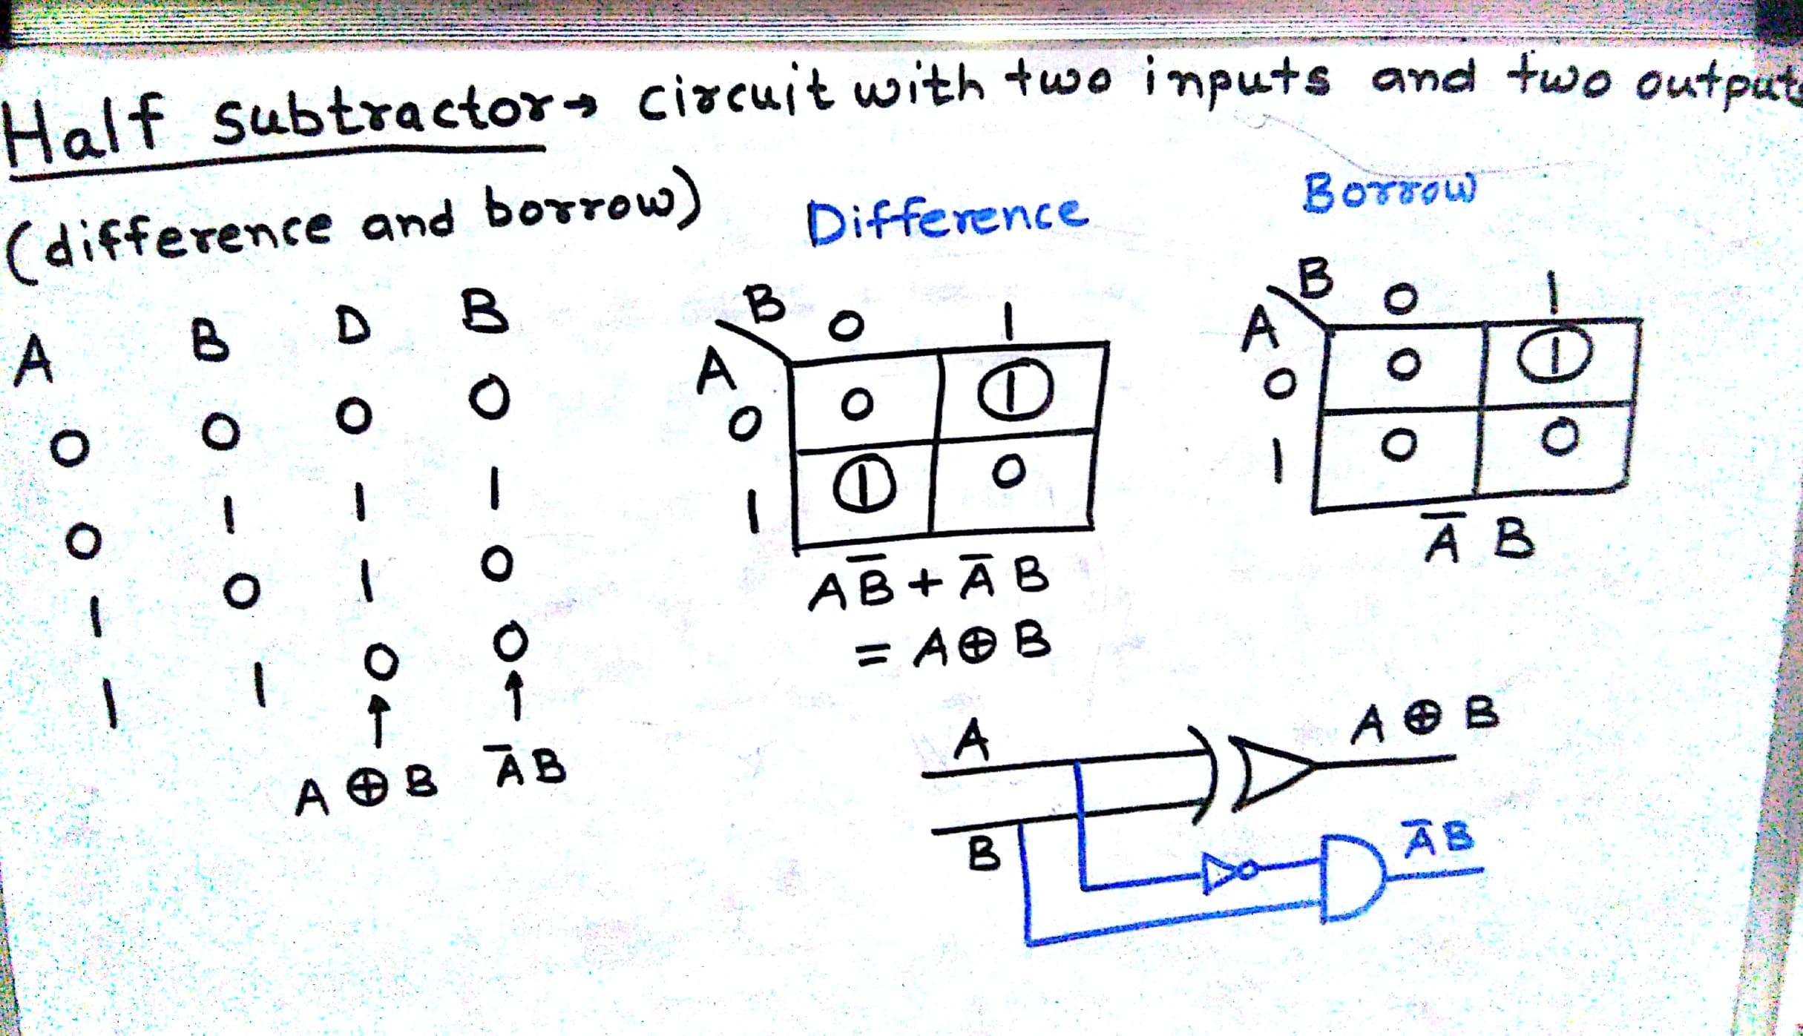
Two variable k-map
Department of Computer Engineering

Slide 16
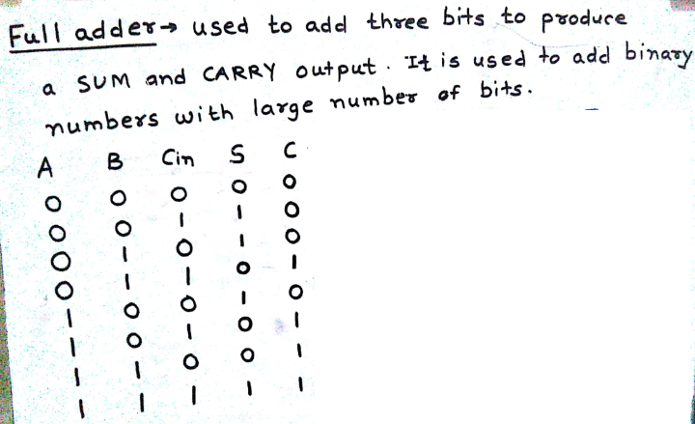
Three variable kmap
Department of Computer Engineering
S= F(A,B, C_{in}) = Σm(1,2,4,7)
C= F(A, B, C_{in}) = Σm(3,5,6,7)

Slide 17
Department of Computer Engineering
F (A,B,C,D) = Σm(0,1,2,3,5,7,8,9,11,14)

Slide 18
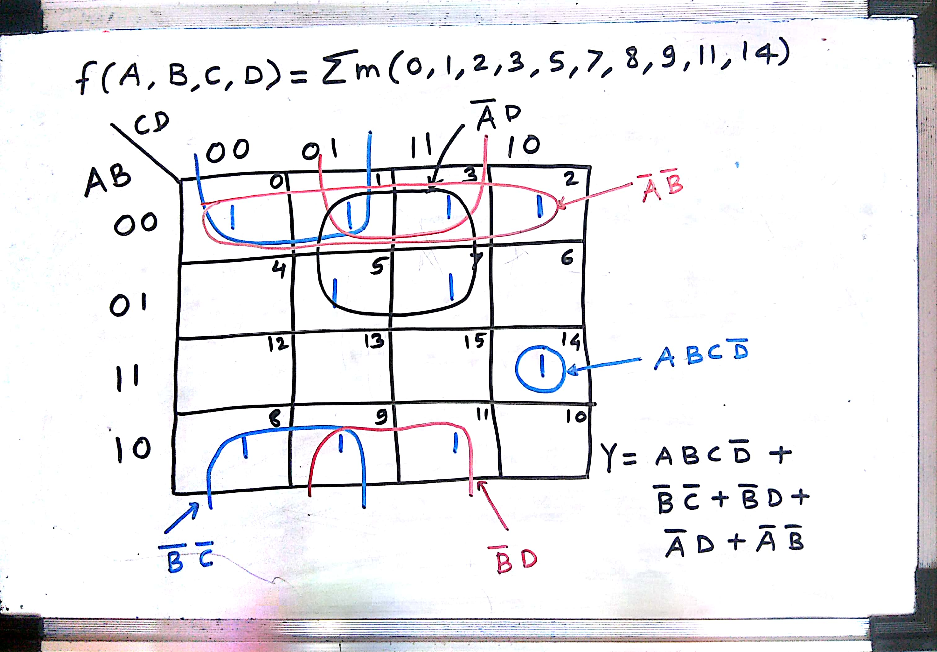
Department of Computer Engineering

Slide 19
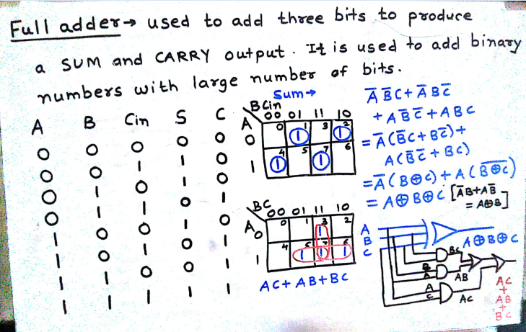
Three variable kmap
Department of Computer Engineering

Slide 20
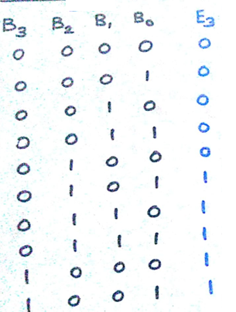
Example 1 : Four variable kmap
Department of Computer Engineering
Function
F(B3, B2, B1, B0) = Σm(5,6,7,8,9)
+ d(10,11,12,13,14,15)

Slide 21
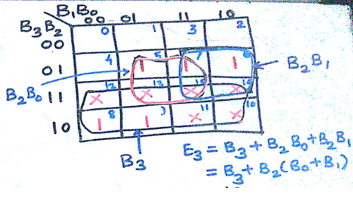
Example 1 : Four variable kmap
Department of Computer Engineering
Function
F(B3, B2, B1, B0) = Σm(5,6,7,8,9)
+ d(10,11,12,13,14,15)

Slide 22
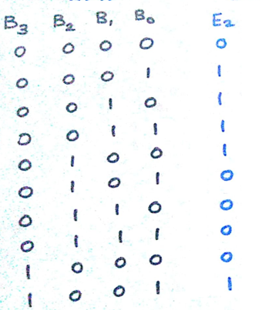
Example 2 : Four variable kmap
Department of Computer Engineering
Function
F(B3, B2, B1, B0) = Σm(1,2,3,4,9)
+ d(10,11,12,13,14,15)

Slide 23
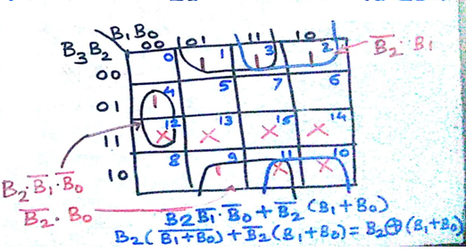
Example 2 : Four variable kmap
Department of Computer Engineering
Function
F(B3, B2, B1, B0) = Σm(1,2,3,4,9)
+ d(10,11,12,13,14,15)

Slide 24
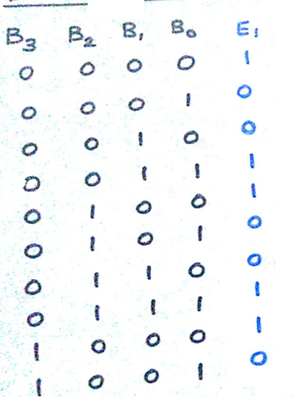
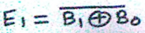
Example 3 : Four variable kmap
Department of Computer Engineering
Function
F(B3, B2, B1, B0) = Σm(0,3,4,7,8)
+ d(10,11,12,13,14,15)

Slide 25
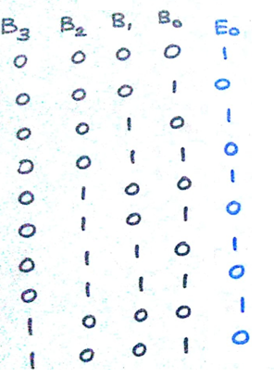
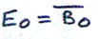
Example 4 : Four variable kmap
Department of Computer Engineering
Function
F(B3, B2, B1, B0) = Σm(0,2,4,6,8)
+ d(10,11,12,13,14,15)

Slide 26
Quiz
Department of Computer Engineering
Please click the following link to open the quiz
testmoz.com/4222220
Crossword – https://crosswordlabs.com/view/unit_1_crossword-120

Slide 27
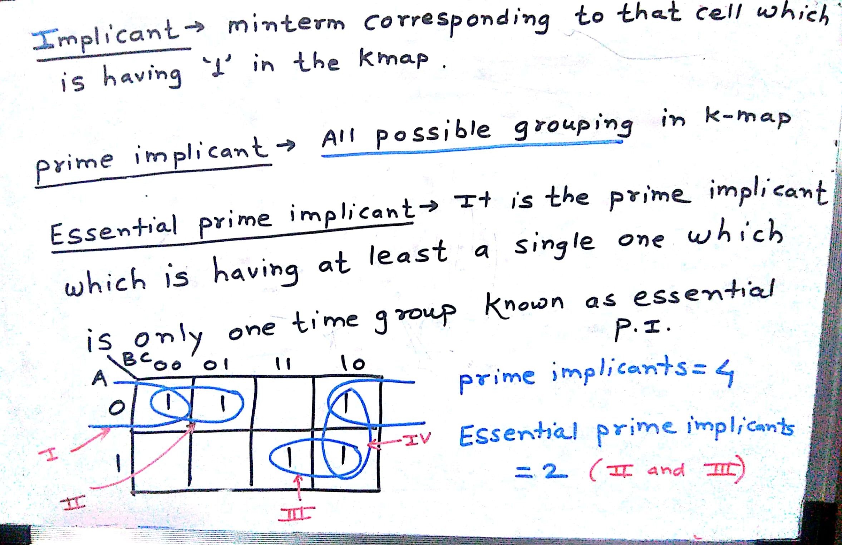
Department of Computer Engineering

Slide 28
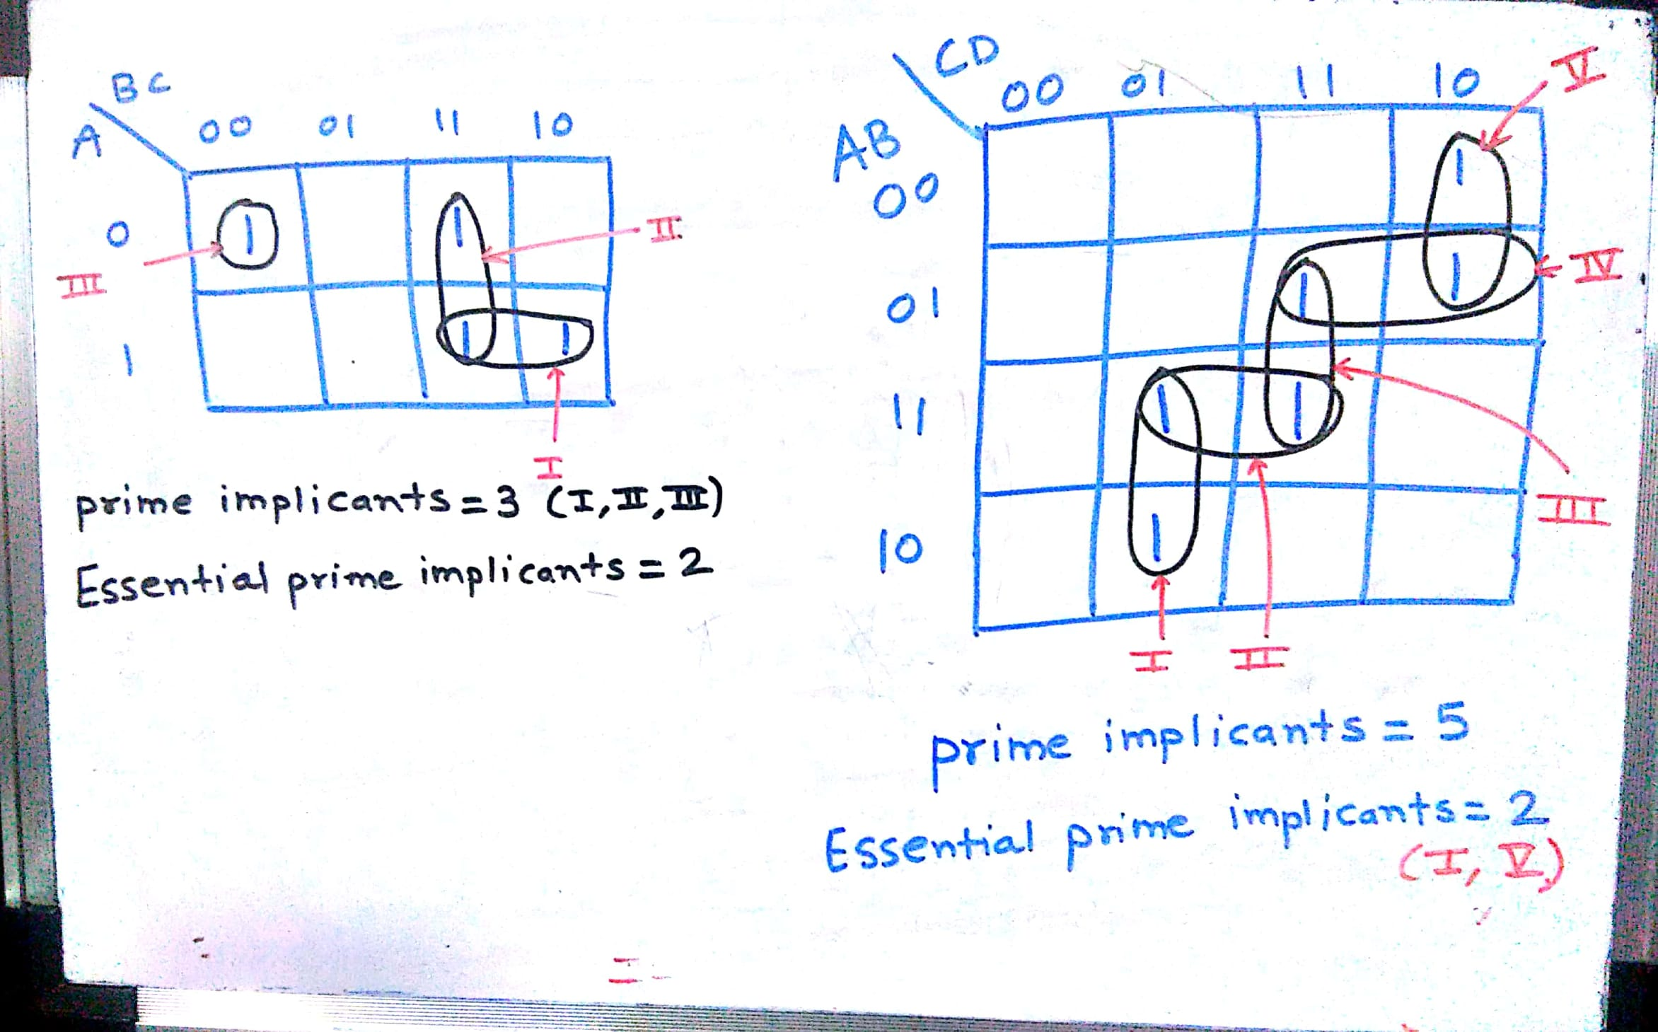
Department of Computer Engineering

Slide 29
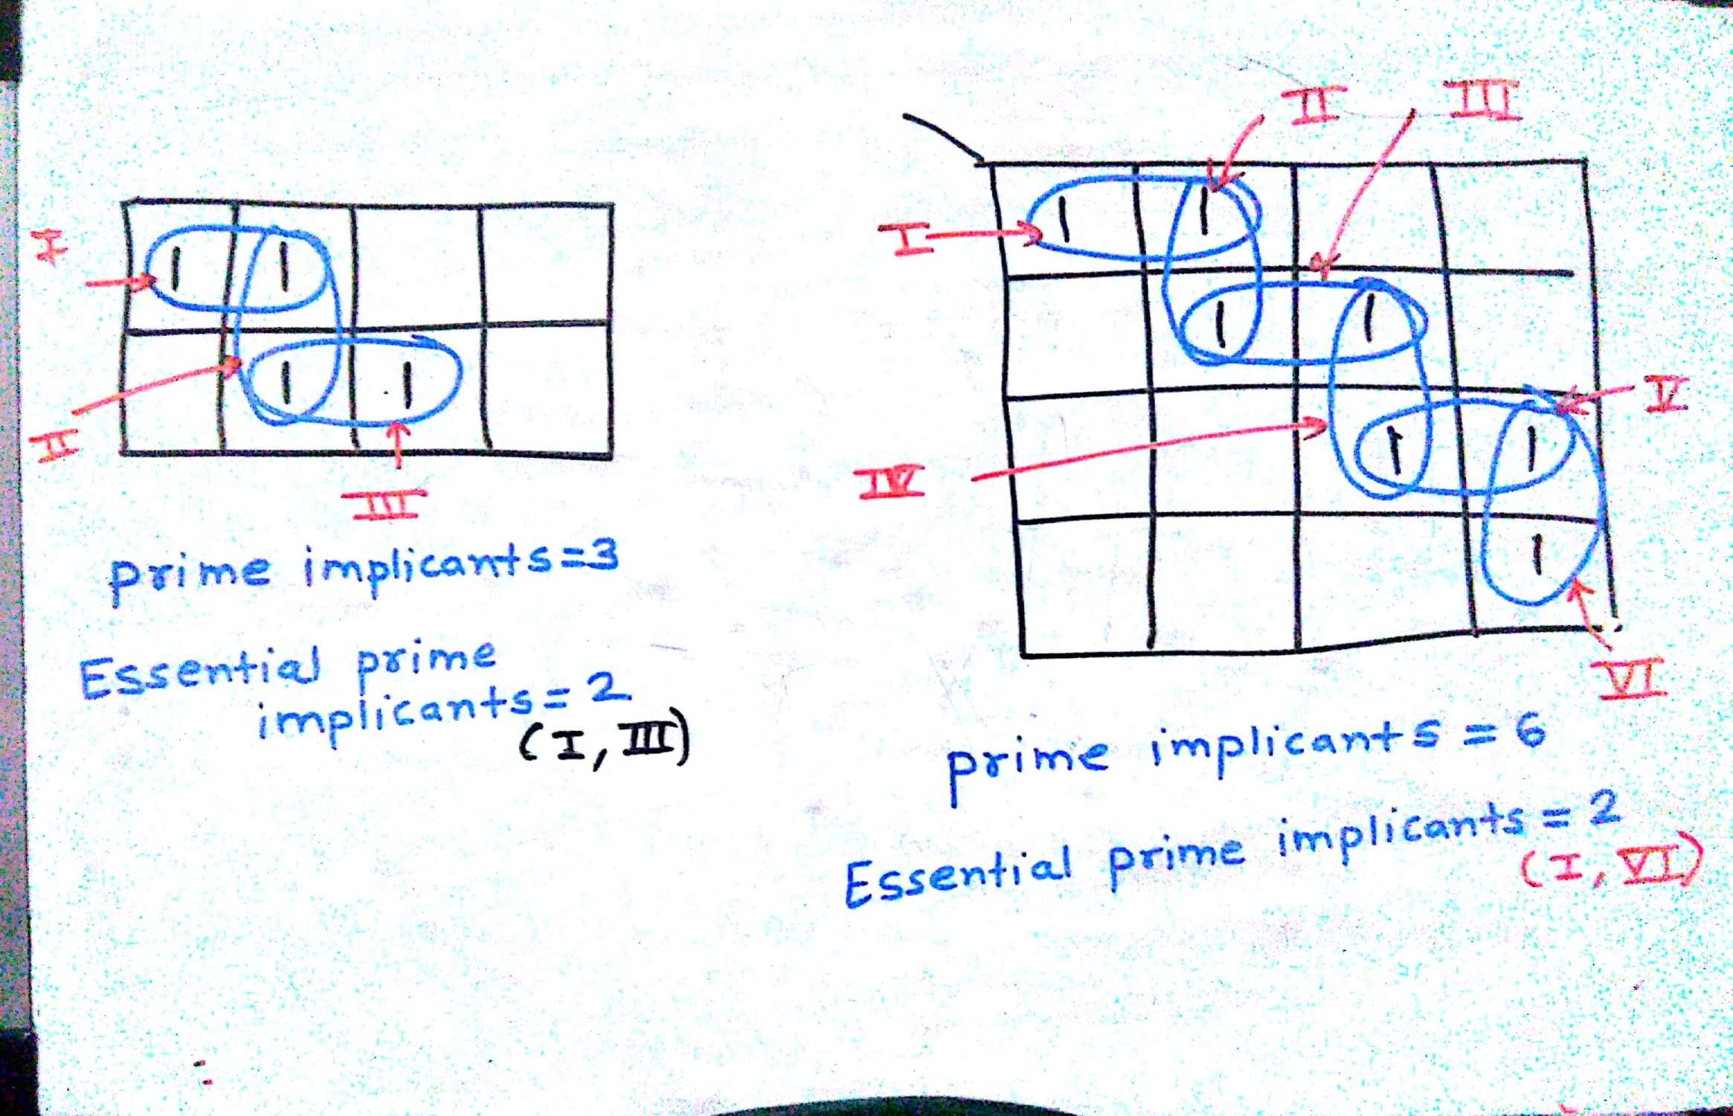
Department of Computer Engineering

Slide 30
Example 1:
Department of Computer Engineering
 |  | 1 | 1
 | 1 | 1
1 | 1

Slide 31
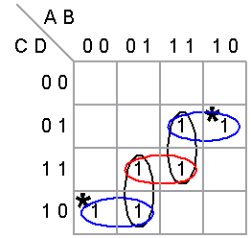
Department of Computer Engineering
Prime implicants = 5
Essential prime implicants = 2
 |  | 1 | 1
 | 1 | 1
1 | 1

Slide 32
Example 2
Department of Computer Engineering
1 |  | 1 | 1
1 | 1
 | 1 | 1
1 |  | 1 | 1

Slide 33
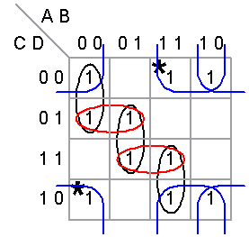
Department of Computer Engineering
Prime implicants – 07
Essential prime implicants - 02
1 |  | 1 | 1
1 | 1
 | 1 | 1
1 |  | 1 | 1

Slide 34
Example 3
Department of Computer Engineering
 |  |  | 1
 |  | 1 | 1
 | 1 | 1
1 | 1

Slide 35
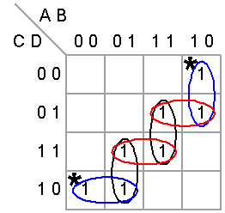
Department of Computer Engineering
 |  |  | 1
 |  | 1 | 1
 | 1 | 1
1 | 1

Slide 36
Example 4
Department of Computer Engineering
1 | 1
1 | 1
1 | 1 | 1
1 |  | 1

Slide 37
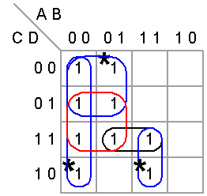
Department of Computer Engineering
Prime implicants – 5
Essential prime implicants - 3
1 | 1
1 | 1
1 | 1 | 1
1 |  | 1

Slide 38
Example 5
Department of Computer Engineering
 | 1
 | 1 | 1
1 | 1 | 1 | 1
1 | 1

Slide 39
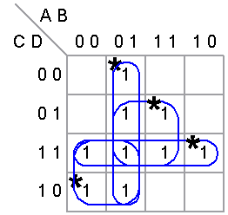
Example 5
Department of Computer Engineering
Prime implicants – 4
Essential prime implicants - 4
 | 1
 | 1 | 1
1 | 1 | 1 | 1
1 | 1

Slide 40
Example 6
Department of Computer Engineering
 | 1 | 1
1 | 1 | 1 | 1
1 |  | 1 | 1
 |  | 1

Slide 41
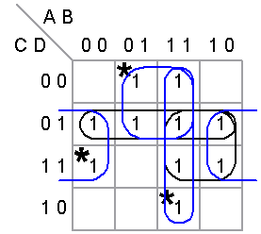
Example 6
Department of Computer Engineering
Prime implicants – 5
Essential prime implicants - 3
 | 1 | 1
1 | 1 | 1 | 1
1 |  | 1 | 1
 |  | 1

Slide 42
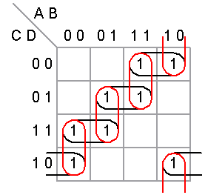
Example 7
Department of Computer Engineering
 |  | 1 | 1
 | 1 | 1
1 | 1
1 |  |  | 1

Slide 43
Example 7
Department of Computer Engineering
Prime implicants – 8
Essential prime implicants - 0
 |  | 1 | 1
 | 1 | 1
1 | 1
1 |  |  | 1

Slide 44
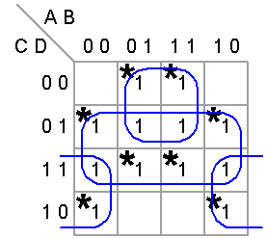
Example 8
Department of Computer Engineering
 | 1 | 1
1 | 1 | 1 | 1
1 | 1 | 1 | 1
1 |  |  | 1

Slide 45
Example 8
Department of Computer Engineering
Prime implicants – 4
Essential prime implicants - 3
 | 1 | 1
1 | 1 | 1 | 1
1 | 1 | 1 | 1
1 |  |  | 1

Slide 46
Summary
Department of Computer Engineering
Karnaugh map allows us to represent functions with new notation
Representation allows for logic reduction.
Each square represents one minterm
Each circle leads to one product term
Implicant and examples

Slide 47
Department of Computer Engineering
Thank you

